Slide 1


MSC3182
SOCIAL ENTREPRENEURSHIP
Lesson 5
BUILD SOLUTION DEMO (MOCKUPS)

Slide 2
BUILD SOLUTION DEMO
The smallest possible solution that can stand in for the actual solution for testing – just the core components
Don’t want to invest a lot in building a full fledged product or service that no one wants
Instead create a demo or mockup of your solution and test run it with your customers
This is a lean startup technique which helps to validate your solution
Mock-up: a full-sized structural model built to scale chiefly for study, testing, or display.

Slide 3
BUILD SOLUTION DEMO

Slide 4
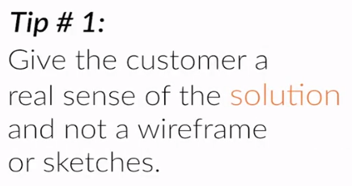
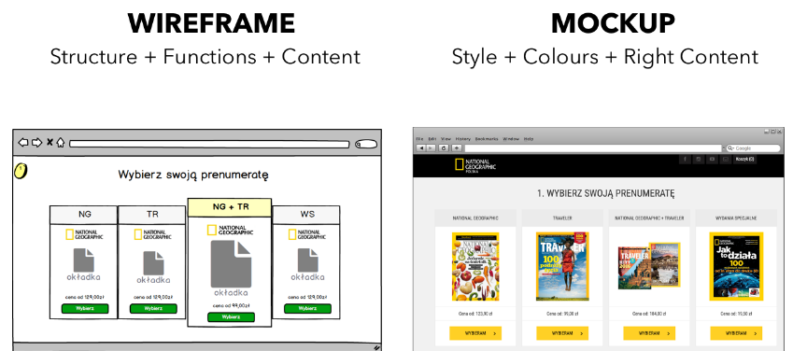
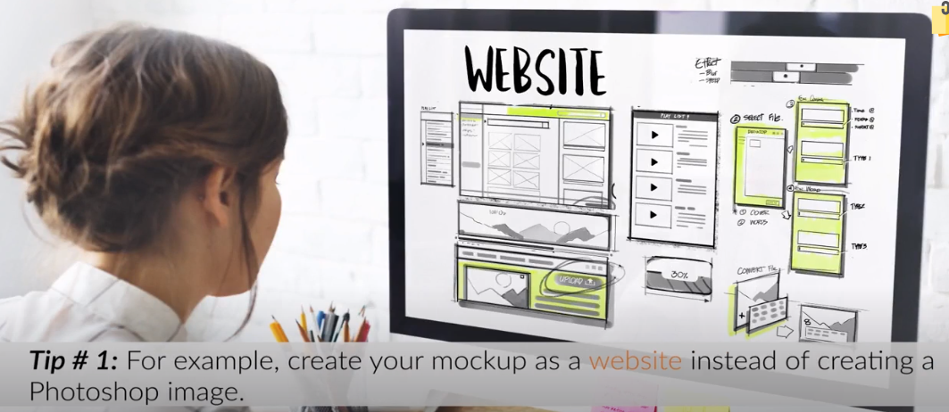
TIPS TO BUILD A SOLUTION DEMO

Slide 5
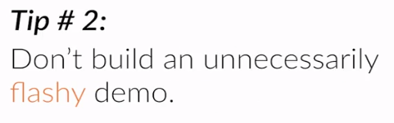
TIPS TO BUILD A SOLUTION DEMO
Building a demo often make us want to be creative
While the flashy demo will make the sales team implementation difficult
Mock up should be something which can be make into product easily
E.G.
Creating a flash video in the demo with fancy transition of the website user experience and later realizing that the same can not be included the in your solution i.e. Website

Slide 6
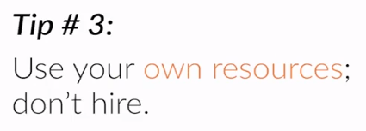

TIPS TO BUILD A SOLUTION DEMO
Use your own resource as far possible so that you can quickly develop another version of demo for testing

Slide 7
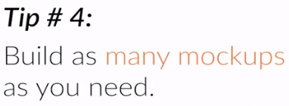
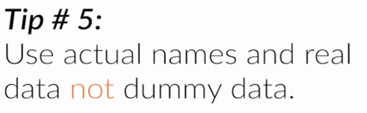
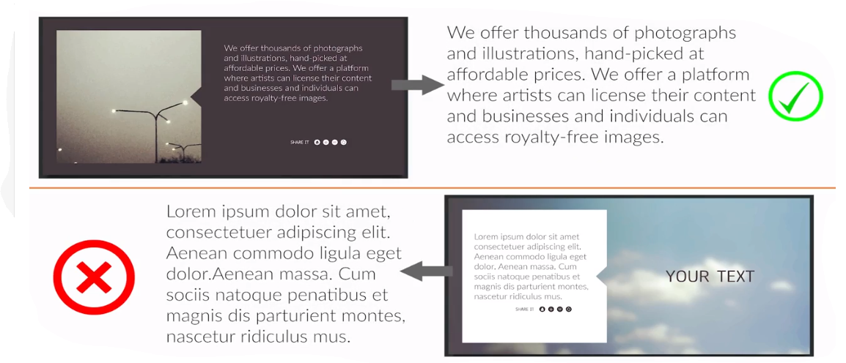
TIPS TO BUILD A SOLUTION DEMO

Slide 8
CONCLUSION
BUILDING MOCKUPS THIS WAY LET YOU TEST YOUR SOLUTION AND SHOW SOMETHING VERY CLOSE TO THE REAL PRODUCT

Slide 9
FURTHER READING
Activity Instructions: Build Your Solution Demo (Mock-ups)
Handout

Slide 10
PROBLEM-SOLUTION FIT
“Before investing months or years of effort towards building a product, the first step is determining if this product is something worth doing.” – Ash Maurya, Running Lean
Don’t start building any solution before making sure you achieved Problem-Solution Fit.

Slide 11

PROBLEM-SOLUTION FIT

Slide 12
FURTHER READING
Activity
Compile Results from Solution Interviews - Handout

Slide 13
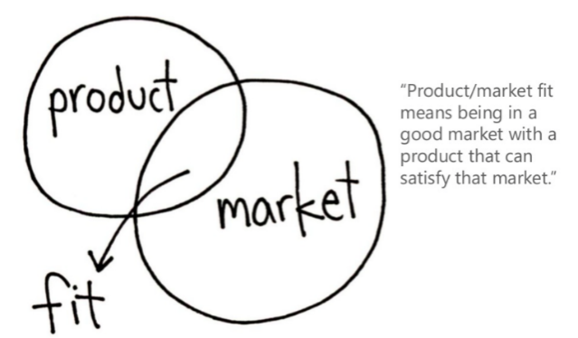
ACHIEVING PRODUCT-MARKET FIT
Your solution/product is close to achieving product-market fit when at least the majority of your early adopters buy your MVP (minimum viable product).
Specifically, they should:
Confirm that the solution does solve (some) their problem
Accept the price of your product
Agree to recommend your product to others
Provide positive testimonials

